Slide 1
State Transition Diagrams
Dynamic Modelling

Slide 2
An object’s state and behaviour can be affected by:
  Changes to attribute values
  Results of operations
  Changes of links with other objects
  Internal events
  External events

Slide 3
Three models
Object model:
  Static structure of objects in a system and their relationships.
  Contains class diagrams.
dynamic model;
  describes aspects that change over time: state transition diagrams
functional model;
  Use Case diagrams

Slide 4
Dynamic modelling
Events
states
state diagrams
conditions
operations

Slide 5
Events
Something that happens at a point in time
  Mouse button clicked / Signal changes
Logically ordered events - causally related
Concurrent events - causally unrelated
  do not effect each other
  there is no order between them
1-way transmission of information from one object to another

Slide 6
Event classes
Event occurrences are grouped into event classes
  Flight 123 departs from Chicago / Flight 456 departs from Rome
  Event class is Flight Departs
Attributes of event classes
  Departure origin of flight
  Flight number
Data values are Attributes

Slide 7
Event Classes and Attributes
Aeroplane flight departs (airline, flight no, city)
Mouse button pushed (button, location)
Input string entered (text)
phone receiver lifted
digit dialled (digit)
engine speed enters danger zone

Slide 8
States
A state is an abstraction of the attribute values and links of an object. Sets of values are grouped together into a state according to properties that affect the gross behaviour of the object.
E.G.. A bank is solvent or insolvent depending on whether it’s assets exceed it’s liabilities.
A state corresponds to the interval between 2 events received by an object.
  A state separates 2 events.
  An event separates 2 states.

Slide 9
Characterisations of a state
State: Alarm ringing
Description: alarm on watch is ringing to indicate target time
Event sequence that produces the state:
set alarm (target time)
any sequence not including clear alarm
current time = target time

Slide 10
Condition that characterises the state:
alarm = on,
and
target time <= current time <= target time + 20s
and
button has not been pushed since the target time

Slide 11
Events accepted in the state:
event action next state
current time = target time + 20s reset alarm normal
button pushed (any button) reset alarm normal

Slide 12
State Diagrams
Relates to a specific object
Relate states and events
A change of state is called a transition
All transitions leaving a state must correspond to different events
The transition fires
An event that has no transition is ignored
A sequence of events corresponds to a path through the graph

Slide 13
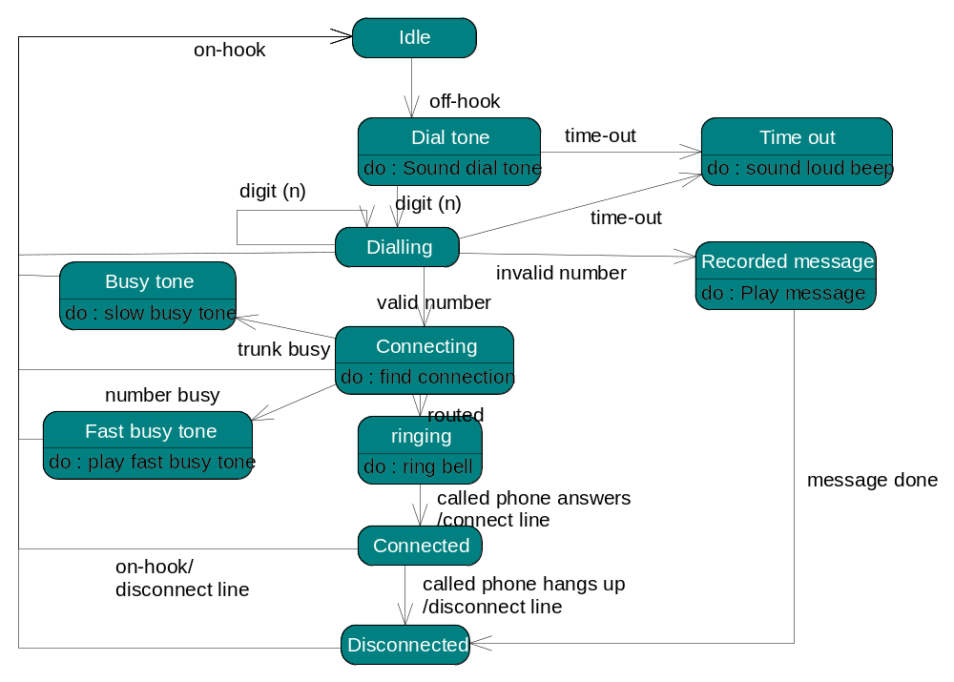
State Transition Diagram

Slide 14
Initial/final States
The previous example is a continuous loop
Most situations will have an initial and final state
Chess game
White's turn
checkmate
Start
stalemate
white wins
White
Black
moves
moves
stalemate
Draw
Black's turn
Checkmate
Black wins

Slide 15
Conditions
Used as guards on transitions.
  A guarded transition only fires when the condition is true e.g.
    When you go out in the morning (event),
    If the temperature is below freezing (condition).
    Put on your gloves (next state).

Slide 16
State Transition Diagram With Conditions
Traffic light
time-out[cars in N/S right lanes]
North/south may go straight
North/south may turn right
time-out
time-out[no cars
Time-out
in N/S right lanes]
time-out[no cars
in E/W right lanes]
East/west may turn right
East/west may go straight
Time out[cars in E/W
right lanes]

Slide 17
Operations
Attached to state
Performed in response to the state
Attached to a transition
Performed in response to the event

Slide 18
Activities and Actions
An activity is an operation that takes time.
  E.G.. Display a picture on a screen.
  “Do:a ” indicates that activity A occurs throughout the lifetime of the state to which it is attached.
An action is an instantaneous operation.
  E.G.. Disconnect phone line.
  An action is shown on a transition as “action / event.”

Slide 19
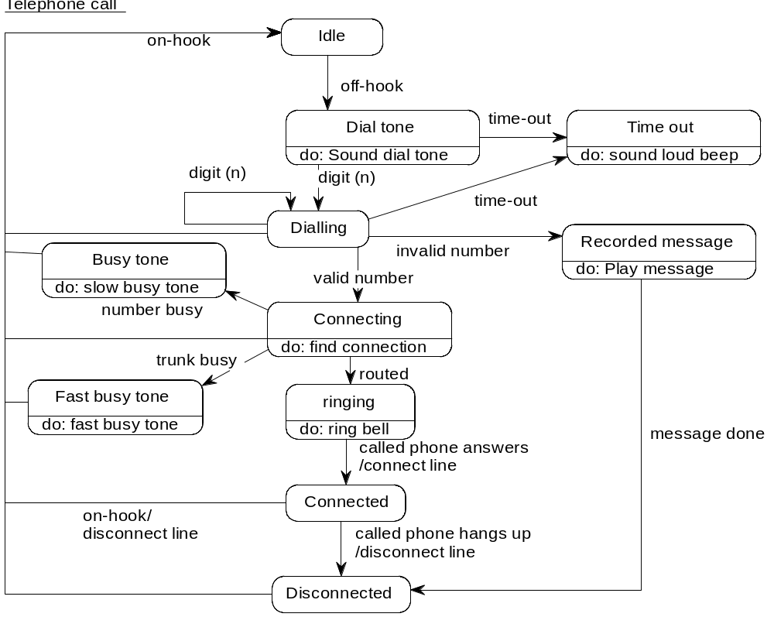

Slide 20
Nesting Diagrams
Done by generalising states
  E.G. Aircraft in flight
Done by generalising events
  E.G. Booking clerk books flight

Slide 21
Exercise 1 - Claims
A third party claim arises from an incident that has occurred. The claim must be reported to the claims office within the statutory period to be valid. When the claim is reported, the incident is preferably verified by a member of staff who was present at the time. The claim is recorded and evaluated. If it is a trivial claim, the claims assessor checks the claimant for previous claims and, if there are no or 1 previous claims then a payment is made and the claim is settled. If there are previous claims, the claimant will be referred to the courts. More serious claims may await expert evidence and several different court hearings. At any stage, the claim may be dropped, or a payment made without admitting liability. If the claimant is a minor, the claim must remain on the books until the claimant is over 21. If a claim is settled by a court, it may be appealed. During this time, the claim remains open.
Draw a state diagram for a claim.

Slide 22
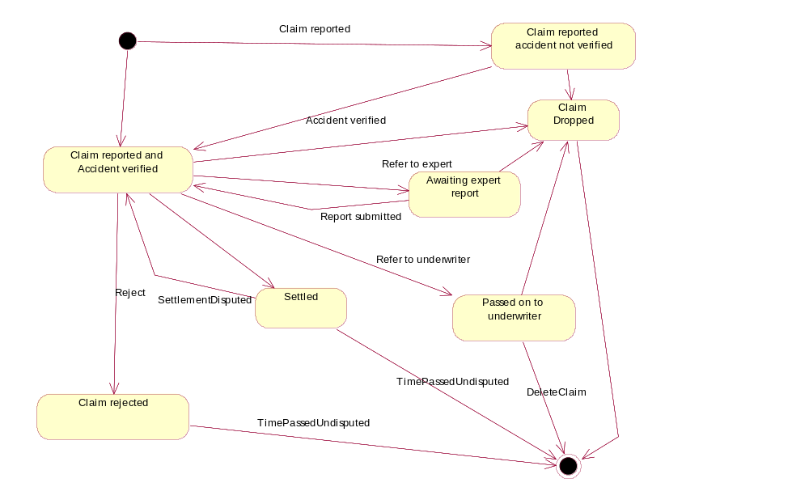

Slide 23
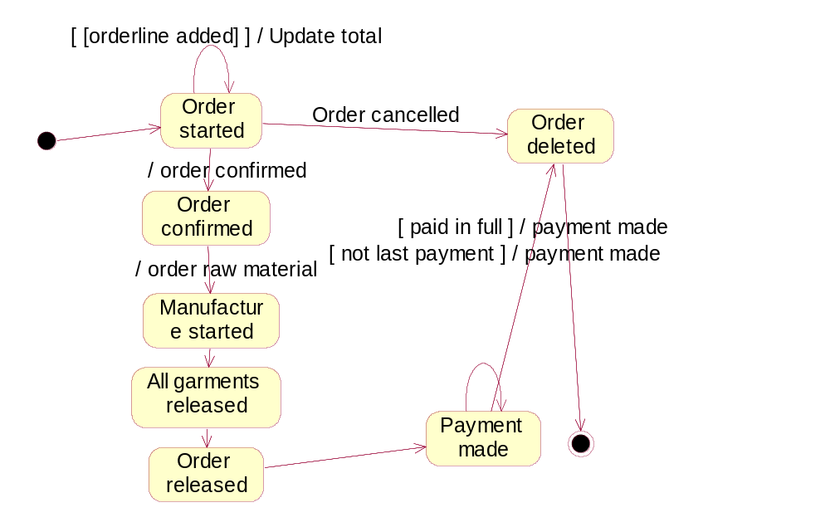
States of Order

Slide 24
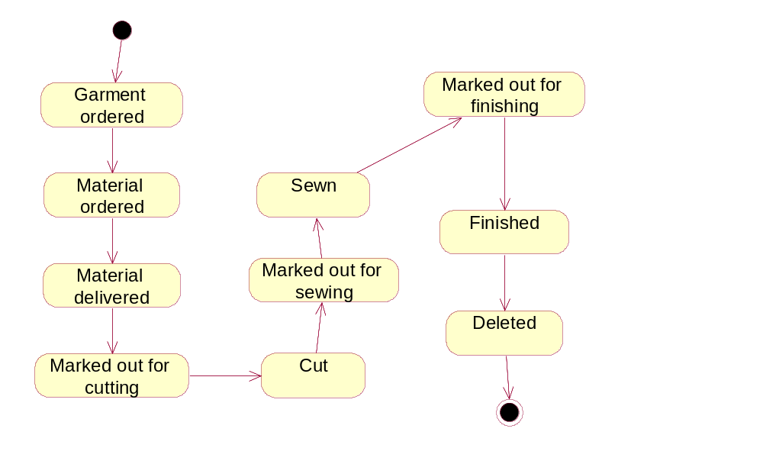
States of Garment (Garments system)

